Slide 1
STATISTICAL FOUNDATIONS FOR MACHINE LEARNING
Hypothesis Testing and Regression Analysis
Course: Foundations of Data Analysis (Group A)
Trainer: Victor Lumumba Wandera
Date: 5th February 2026
Dataset: Hypertension Clinical Cohort (htn_dat.csv)
Foundations of Data Analysis – Group A
Bridge Module to Week 3 Machine Learning

Slide 2
Why Statistics Before Machine Learning?
Machine Learning is applied statistics at scale.
Key statistical foundations:
Hypothesis testing for decision-making
Regression for prediction and inference
p-values and confidence intervals for uncertainty
Healthcare relevance in Kenya:
Logistic regression for hypertension risk prediction
Survival analysis for HIV treatment outcomes
Statistics ensures transparent and responsible AI
Key message:
Machine learning without statistics becomes a black box.

Slide 3
Learning Objectives
By the end of this session, you will be able to:
Formulate and test statistical hypotheses
Interpret regression coefficients correctly
Apply OLS regression for continuous outcomes
Apply logistic regression for binary outcomes
Evaluate models using R², accuracy, and AUC
Connect regression concepts to ML algorithms

Slide 4
Dataset Overview
Dataset: htn_dat.csv
Records: 4,900 patients from Kenyan health facilities
Outcome variables:
SBP (continuous systolic blood pressure)
SBP_ge120 (binary hypertension indicator)
Predictor variables:
Age, BMI, DBP
Gender, marital status
Urban clinic indicator
HIV and ART status
Research question:
Which factors significantly predict hypertension risk?

Slide 5
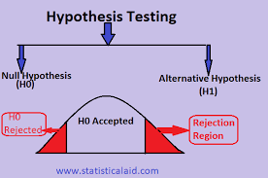
What is Hypothesis Testing?
Hypothesis testing evaluates claims about population parameters.
Null hypothesis (H₀):
No effect or no relationship
Alternative hypothesis (H₁):
An effect or relationship exists
Example:
H₀: BMI is not associated with hypertension
H₁: BMI is associated with hypertension

Slide 6
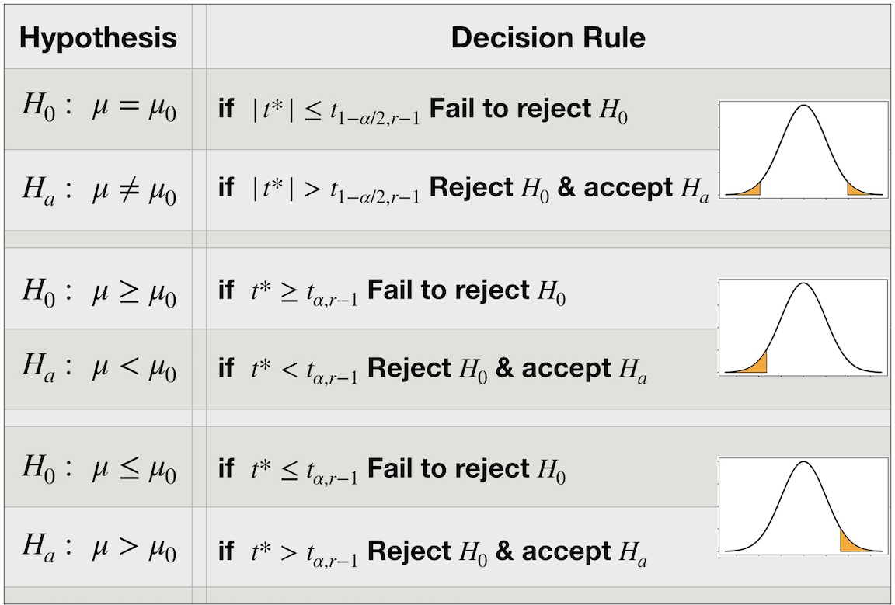
Decision Rule in Hypothesis Testing
Decision based on p-value:
p < 0.05 → Reject H₀
p ≥ 0.05 → Fail to reject H₀
Important principle:
We do not "accept" the null hypothesis.
We only reject or fail to reject it.

Slide 7
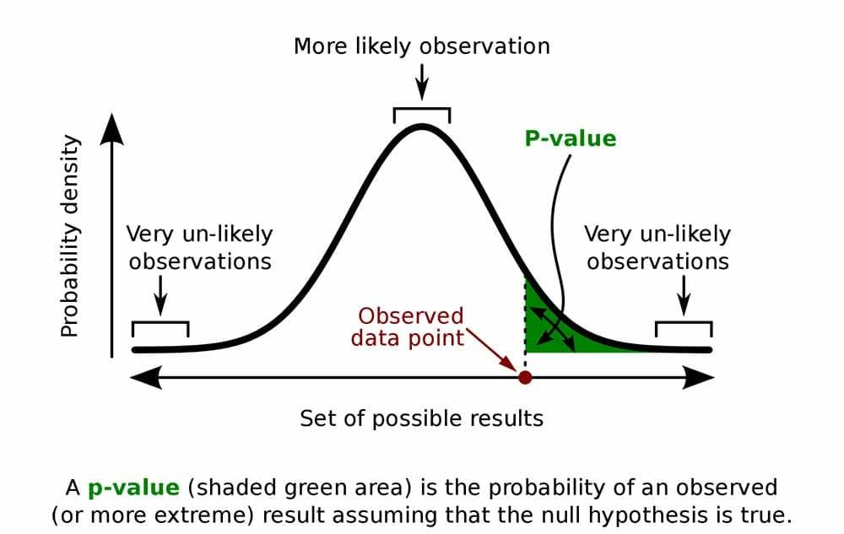
Understanding p-values
A p-value measures evidence against the null hypothesis.
Definition:
Probability of observing the data (or more extreme)
assuming the null hypothesis is true.
Interpretation:
Small p-value → Strong evidence against H₀
Large p-value → Weak evidence against H₀

Slide 8
Medical Example of a p-value
Hypothesis:
H₀: Mean SBP is equal in urban and rural clinics
H₁: Mean SBP differs between clinics
Result:
p = 0.003
p-value is compared with alpha (5% (0.05), 10%(0.1), 1%(0.01)
Interpretation:
There is strong evidence that clinic location is associated with systolic blood pressure.

Slide 9
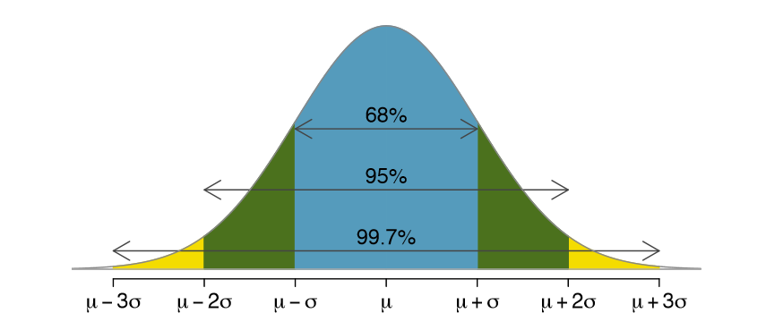
Confidence Interval
A confidence interval provides a range of plausible values for a population parameter.
95% confidence interval:
If the study were repeated many times, 95% of such intervals would contain the true value.
Confidence intervals show:
Effect size
Precision of estimates

Slide 10
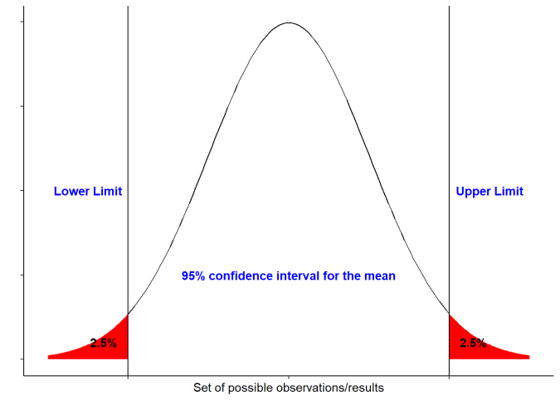
Confidence Interval Example
Mean SBP difference (urban – rural) = 4.2 mmHg
95% CI: [2.1, 6.3] mmHg
Interpretation:
The true SBP difference lies within this range
CI does not include zero → statistically significant
Provides more information than p-value alone

Slide 11
Choosing the Right Statistical Test
Test selection depends on variable types:
Two means → Independent t-test
More than two means → ANOVA
Two categorical variables → Chi-square test
Two continuous variables → Correlation
Continuous outcome → OLS regression
Binary outcome → Logistic regression

Slide 12
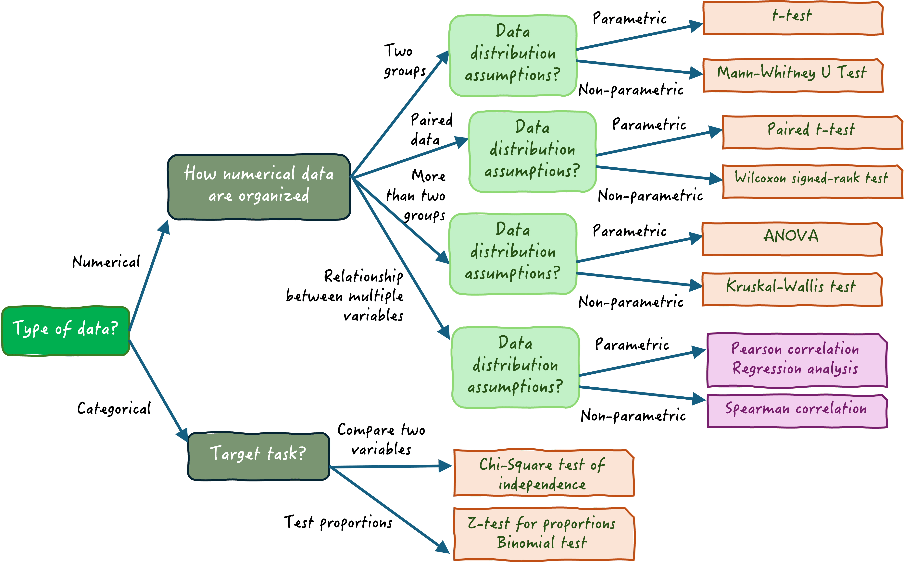

Slide 13
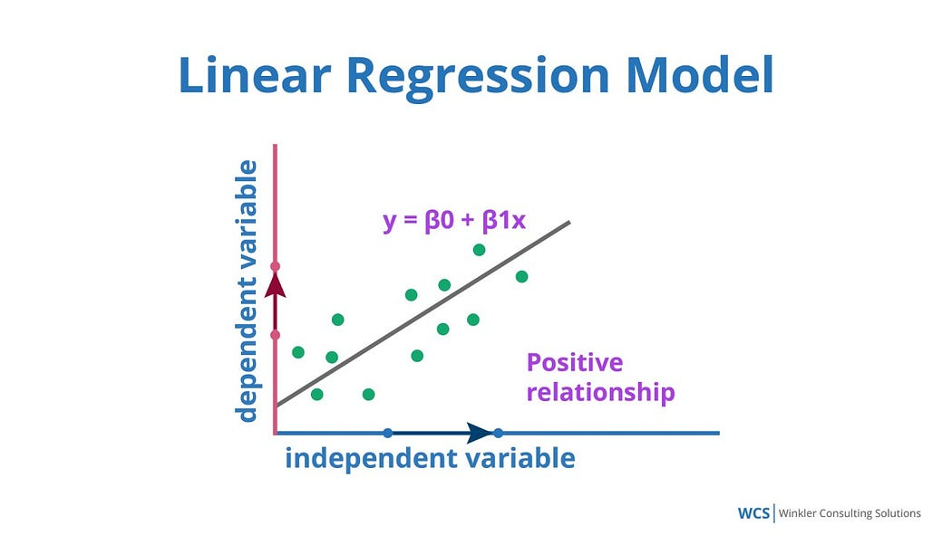
Introduction to Regression Analysis
Regression models the relationship between predictors (X) and an outcome variable (Y).
General form:
Y = β₀ + β₁X₁ + β₂X₂ + ... + ε
Regression is the foundation of many ML algorithms.

Slide 14
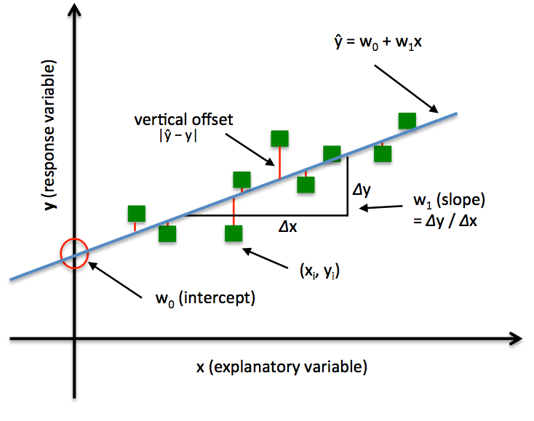
Ordinary Least Squares (OLS) Regression
OLS regression predicts continuous outcomes.
Medical application:
Predict systolic blood pressure using:
BMI
Age
Gender
OLS minimizes the sum of squared prediction errors.

Slide 15
Interpreting OLS Coefficients
Coefficient interpretation:
Sign (+/–): Direction of relationship
Magnitude: Size of effect
p-value: Statistical significance
Example:
A BMI coefficient of 0.87 means SBP increases by 0.87 mmHg per unit BMI increase, holding other variables constant.

Slide 16
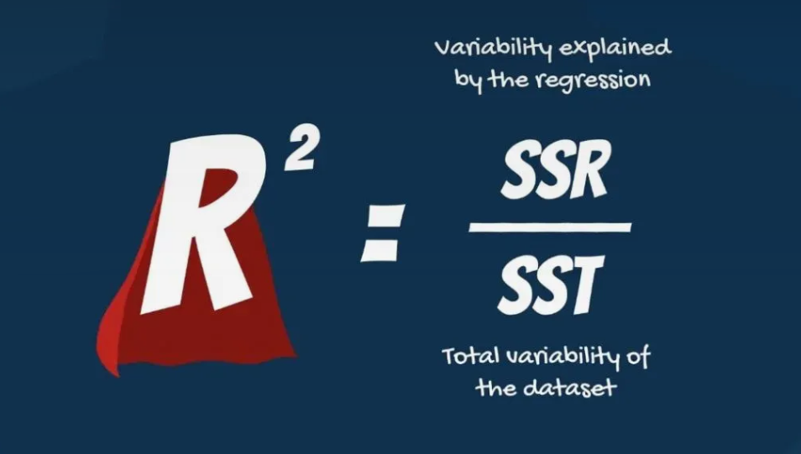
Model Fit in OLS Regression
Key evaluation metrics:
R²: Proportion of variance explained
RMSE: Prediction error magnitude
MAE: Average absolute error
R² does not imply causation, only explanatory power.

Slide 17
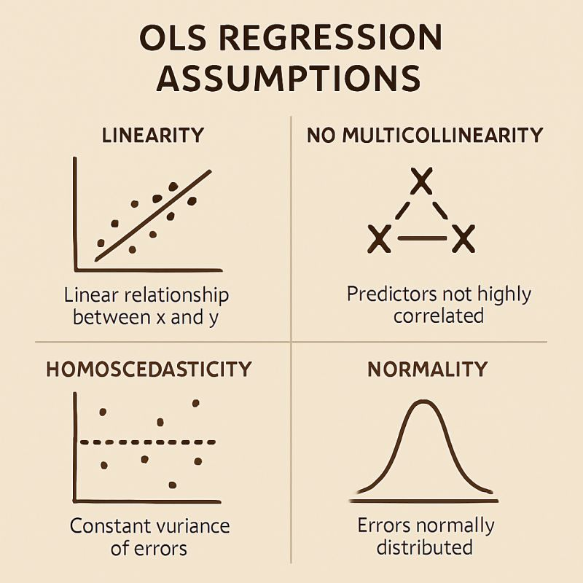
OLS Assumptions
OLS regression assumptions:
1. Linearity
2. Independence of observations
3. Homoscedasticity
4. Normality of residuals
5. No multicollinearity
Violations require transformations or alternative modeling approaches.

Slide 18
Logistic Regression Analysis

